Slide 1
Escape From Elms
Roche Palen
Rebecca Barnett
Niall O’Neill
Ellie Walsh
John Higgins
40301756
40266742
40297272
40289446
40291622

Slide 2
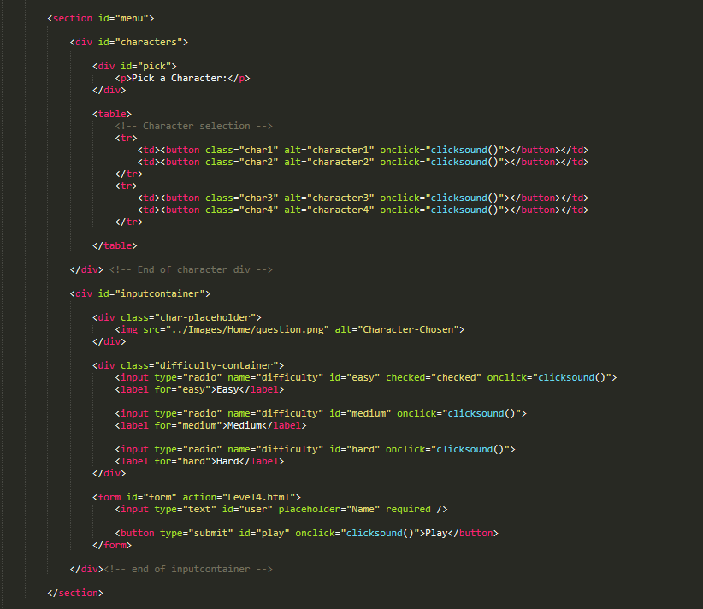
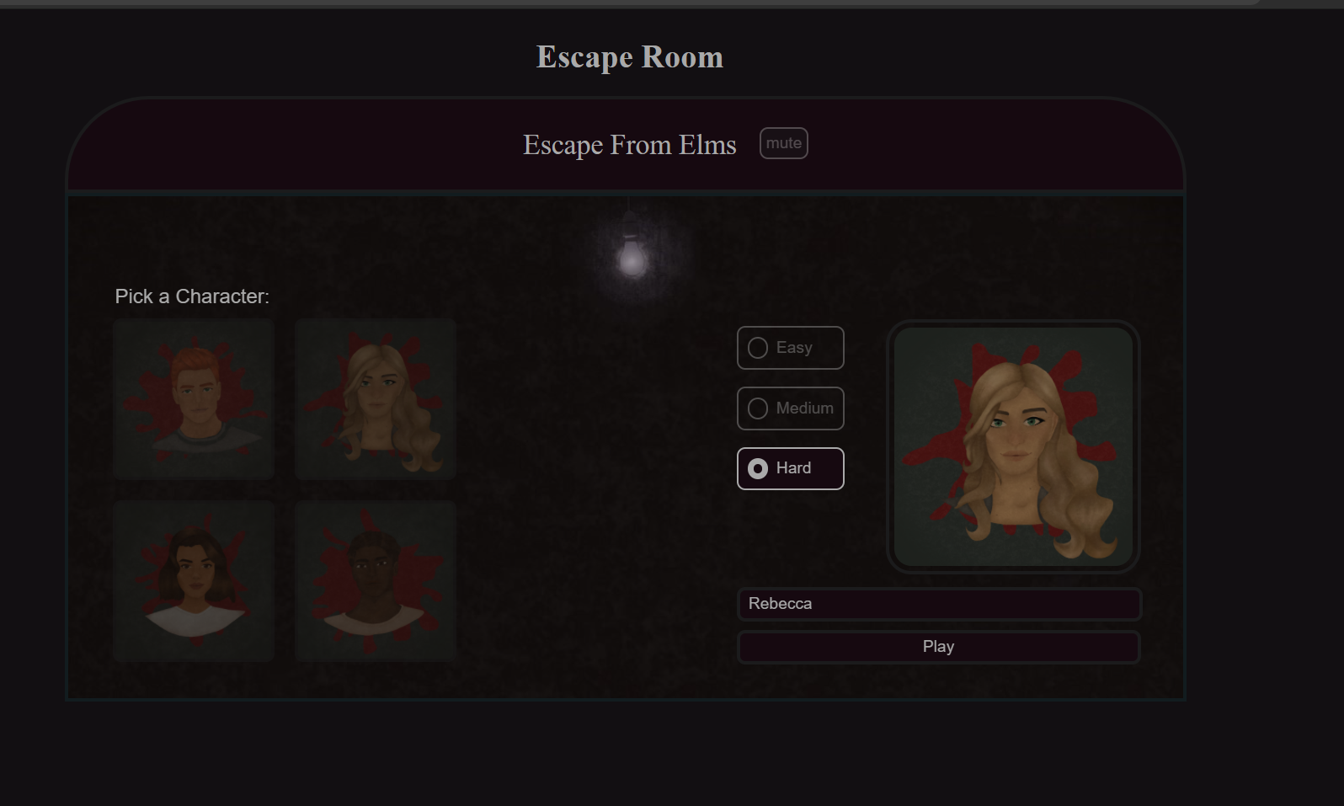
Collection of data using HTML
The user must also select a character to play as
The User is required to enter their name in order to play the game.

Slide 3
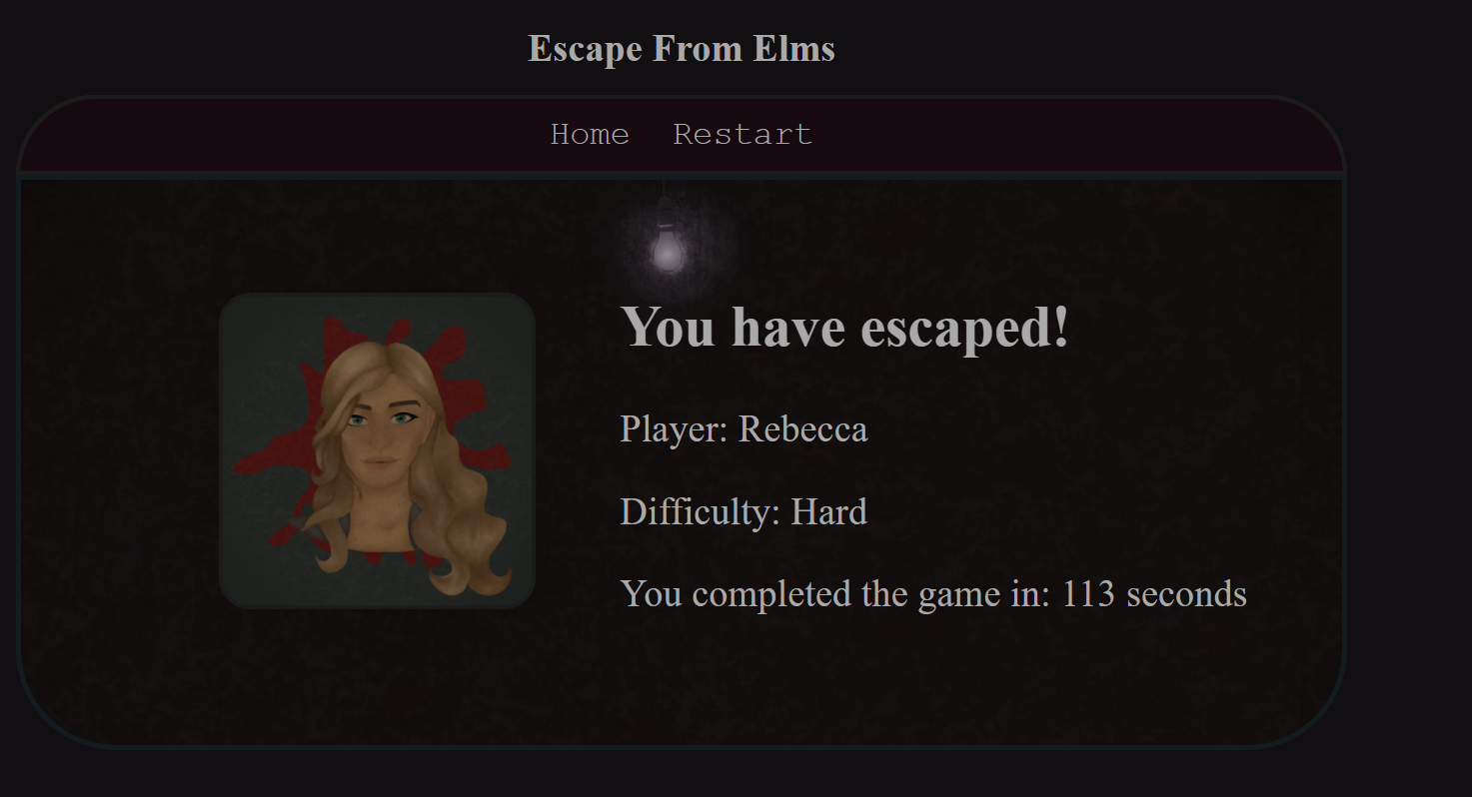
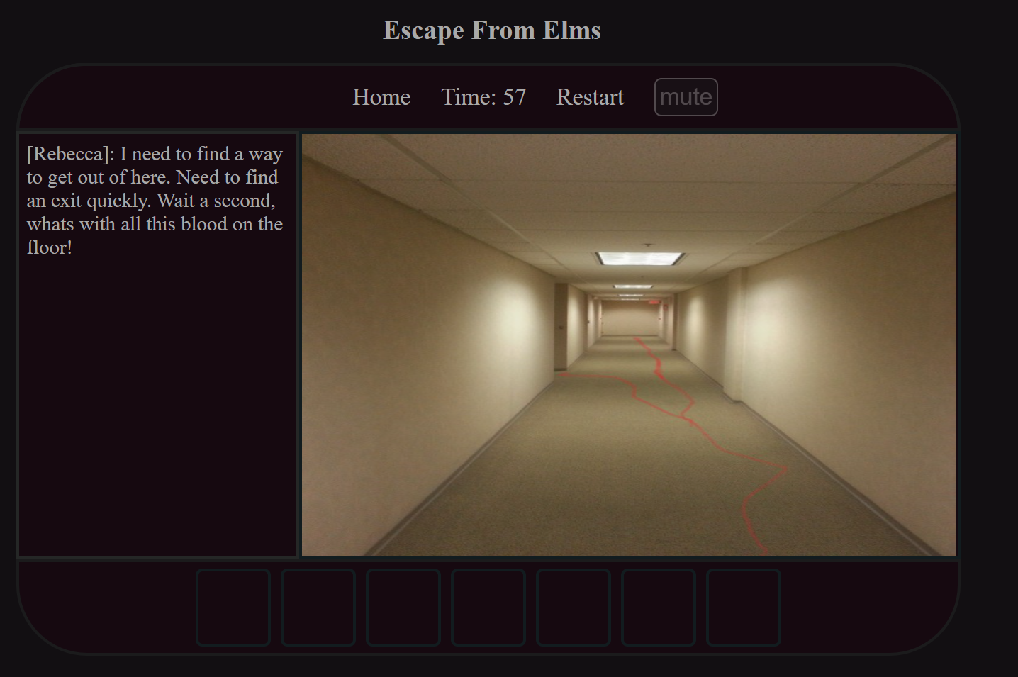
How this Information is used
The Name and the character the user entered/selected in the homepage
The Information is saved, and used to personalise the dialogue that is displayed throughout the game, furthering the immersion that the user can feel within the game.

Slide 4
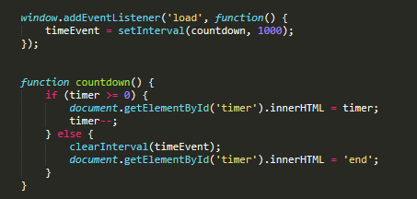

JavaScript timed event
Each level has a countdown timer positioned clearly at the top of the page.
This not only adds a challenge to the game by only allowing the user so much time to complete each level but also allows us to ensure the play time is 5 minutes max.

Slide 5
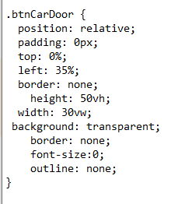
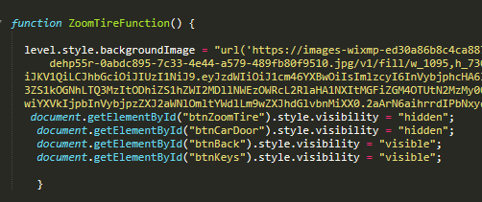
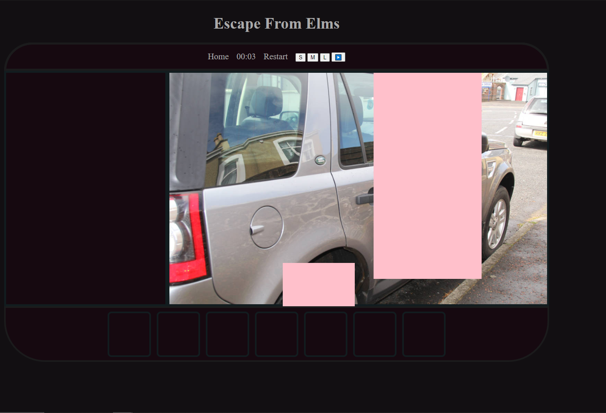
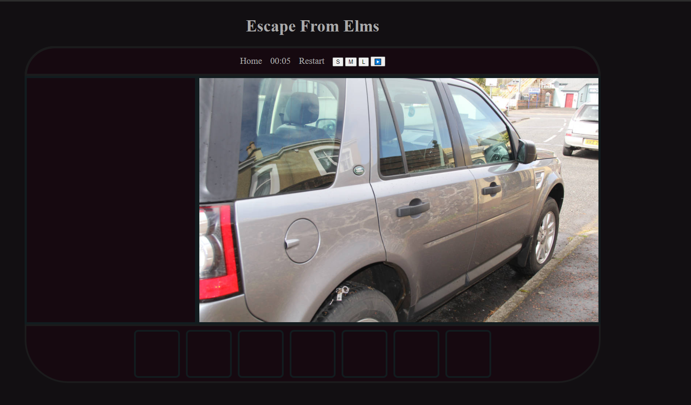
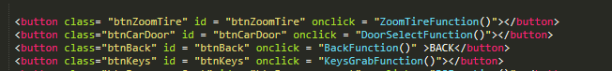
How the Game works:
Difficulty:
At the start of the game the user must select a difficulty, this will determine how many rooms the user must play through in order to escape.
Hidden Buttons
For the majority of the game, it functions by having buttons that have been made transparent that trigger specific events when selected.

Slide 6
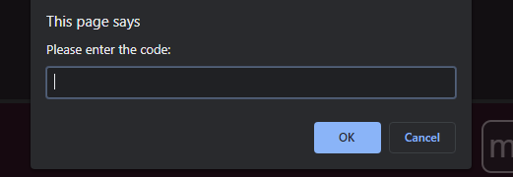
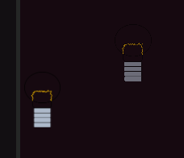
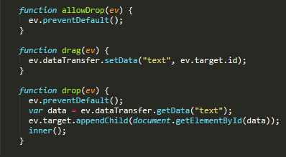
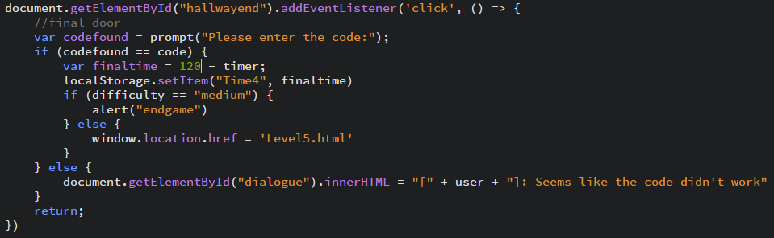
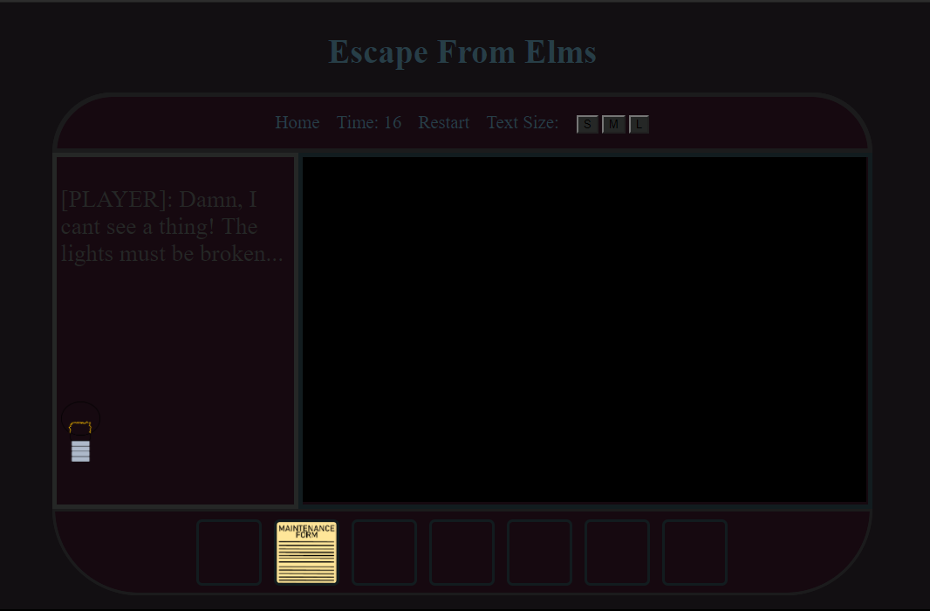
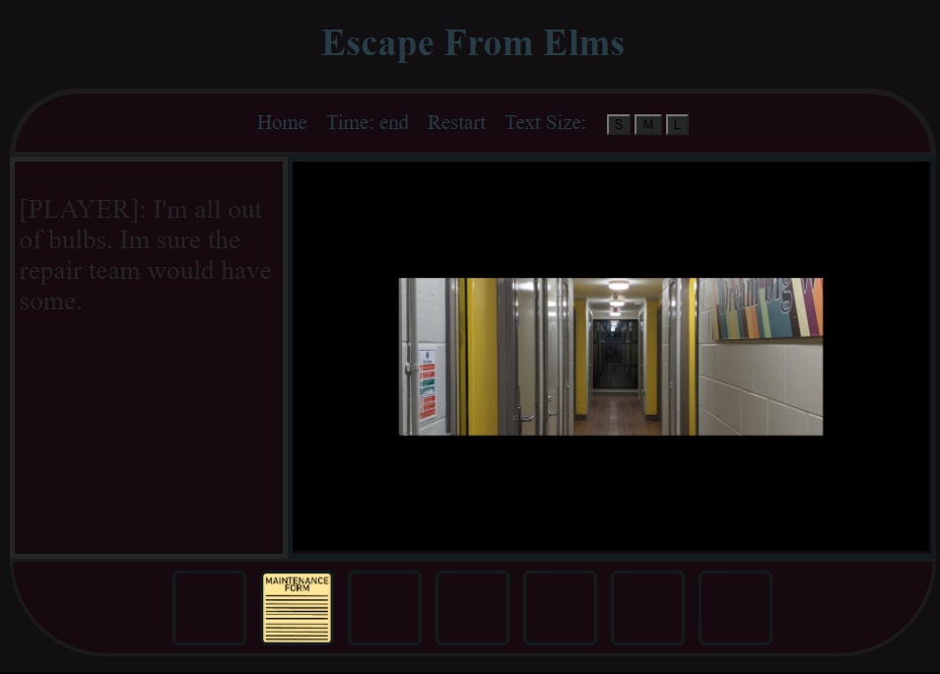
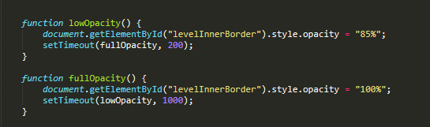
How the Game works continued:
Enter Code:
In Level 4 the user must find their way to the door, finding numbers along the way. The user must then enter the numbers they found in order to escape.
Drag and Drop:
In level 2, the User must drag the light onto the game screen in order to be able to see the game.
Visibility:
In multiple levels, the game screen varies in dimness, either to encourage the play to work faster or to add another function to the game (like turning a light on in order to be able to continue)
The dragged lightbulb
The lightbulb has been dragged onto the game screen

Slide 7
Player Statistics:
The game will save the time the player took to finish each level and output the overall time at the end of the game.

Slide 8
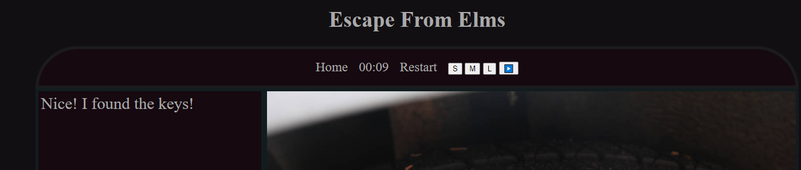
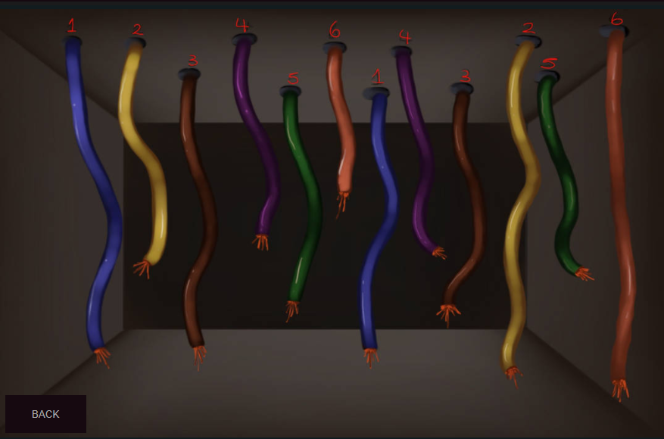
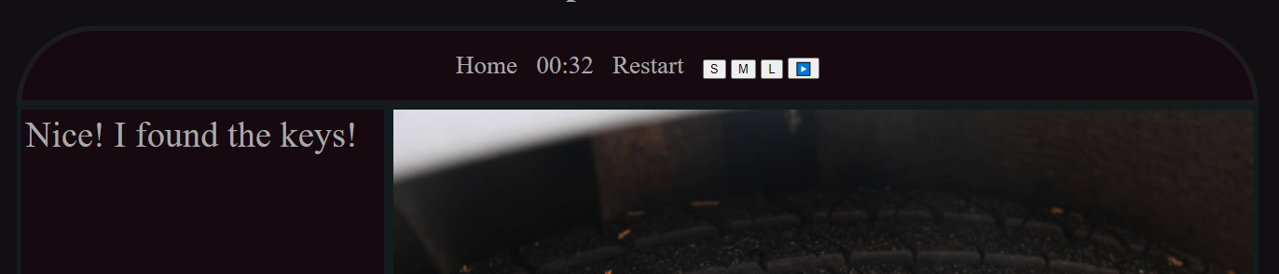
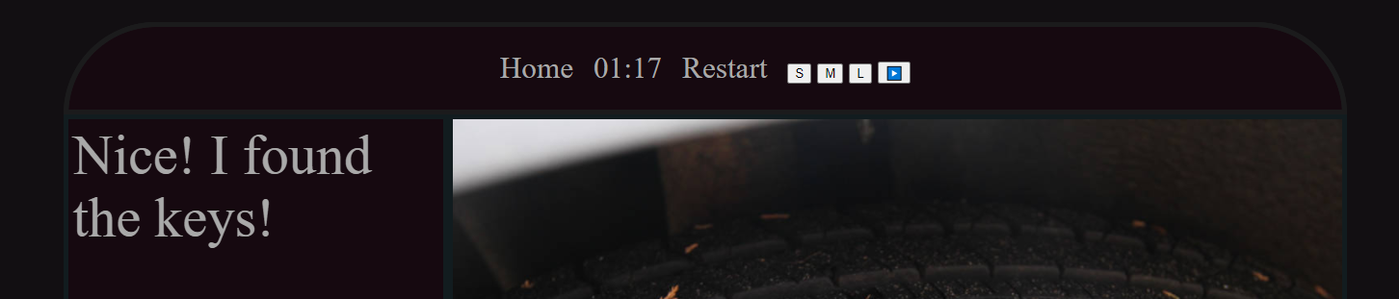
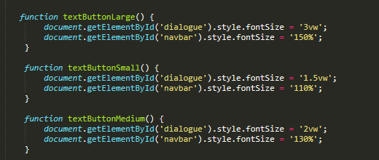
Accessibility
Text resizing for the visually impaired:
Labelling for the colourblind:
Small Text
Medium text
(default)
Large Text

Slide 9
Copyright disclosure:
The Majority of the images used have either been photographed by ourselves.
All drawings have been done by members in ours group.
Websites where copyright free images/sound were sourced:
https://www.pexels.com/royalty-free-images/
https://pixabay.com/
https://www.qub.ac.uk/
https://freesound.org/

